Slide 1
CAPSTONE PROJECT, 2024 base on the SAKILLA DATABASE
Analyzing Rental Patterns and Customer Behaviour in the Sakilla Database
A Data-Driven Approach to Business Optimization
by Paul Ejiroghene Atakere/paulatakere@yahoo.com

Slide 2
INTRODUCTION
Objective:
In today’s competitive market, understanding customer behavior and optimizing operations are key to sustaining growth. This project leverages data from the Sakilla database to uncover actionable insight that can drive business decisions.
Data Source:
Sakilla Database is a standard database provided by AltSchool Africa for learning purposes, containing tables related to a video rental store. This presentation will demonstrate how this data can be utilized to optimize rental patterns, customer behaviors, and overall business performance

Slide 3
PROJECT GOALS
Understanding Rental Pattern:
Identify which movies are rented the most and by whom.
Customer Behavior Analysis:
Segment customers based on rental history and payment behavior.
Revenue Analysis:
Evaluate revenue trends by movie genure, rating, and customer segments.
Inventory Management:
Optimize inventory levels by analyzing DVD availability and turover rates.
Predicting Customer Churn:
Identify factor leading to customer churn and predict likely churners.

Slide 4
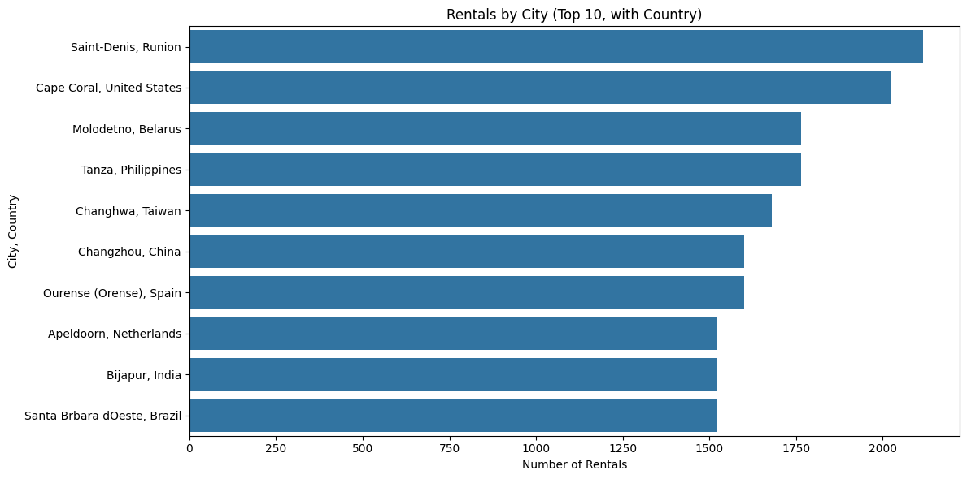
TOP-RENTED VIES MOVIES WITH DEMOGRAPHICS
Analyzing Rental Pattern by Location:
Most of the top-ranking cities are urban areas, indicating a higher concentration of rentals in metropolitan regions that span across various continents, including Europe, Asia and the Americas, showcasing a global appeal for the rental service.

Slide 5
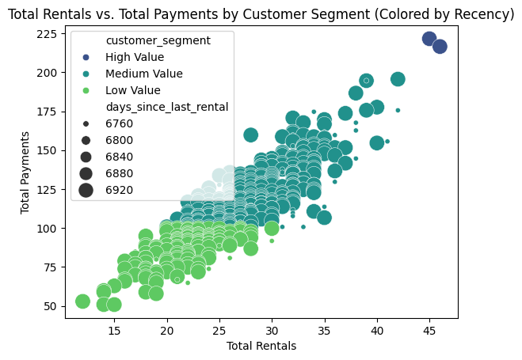
CUSTOMER RENTAL BEHAVIOUR
Segmentations of customers:
High-value customers, though fewer in number, contribute significantly to revenue. Personalized offers and loyalty programs can further enhance their engagement.

Slide 6
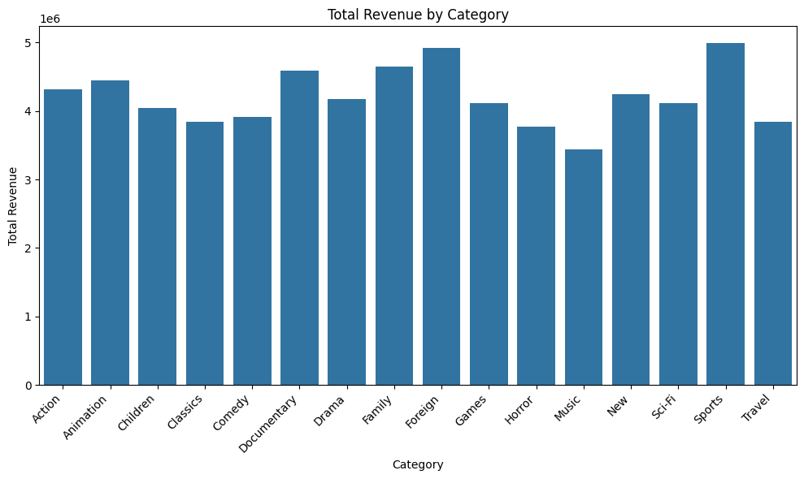
REVENUE ANALYSIS
Breaking Down Revenue AnalysisBreaking Down Revenue Trend:
The data indicates a sike in revenue from horror and thriller genre during halloween season, suggesting season promotions could be highly effective.

Slide 7
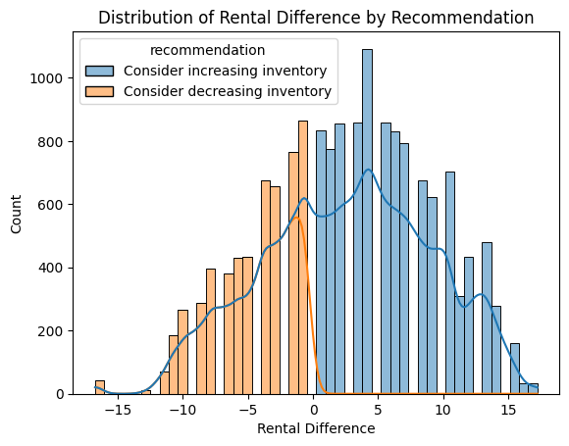
INVENTORY MANAGEMENT
Optimizing inventory level:
High turnover rates for certain genre suggest an opportunity to adjust inventory levels to meets demand, reduce stockouts and improving customer satisfaction.

Slide 8
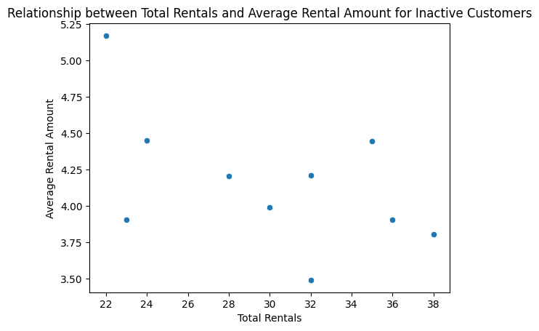
CHURN ANALYSIS
Predicting and preventing customer churn:
Customer who rent infrequently and have low payment histories are more likely to churn. Implementing retention strategies, such as personalized discounts or exclusive contents, can help reduce churn rates.

Slide 9
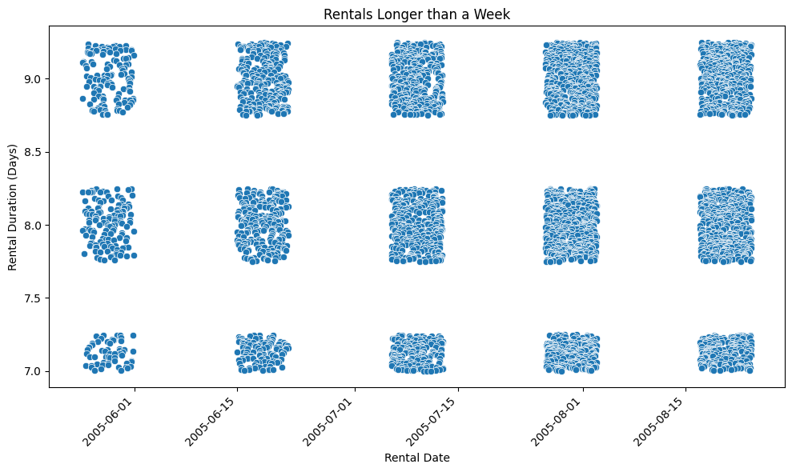
RENTAL DURATION ANALYSIS
Understanding rental duration trend:
Longer rental durations are linked with satisfaction scores, suggestion the need for flexible rental policies to enhance customer experience.

Slide 10
KEY TAKEAWAYS
Summary of insights
Top-Rented Movies: Target promotions by demographic preferences.
Customer Segmentation: Focus on high-value customers with personalized marketing.
Revenue Analysis: Leverage seasonal trends for targeted campaigns.
Inventory Management: Adjust stock based on demand patterns to optimize availability.
Churn Prediction: Implement retention strategies to reduce customer attrition.

Slide 11
ACTIONABLE INSIGHTS
Concrete Recommendations
Inventory Optimization: Regularly review stock levels based on rental trends to avoid overstock or stockouts.
Customer Engagement: Develop personalized marketing strategies for high-value customers.
Retention Strategies: Offer loyalty programs or discounts to retain low-frequency renters.

Slide 12
FUTURE DIRECTIONS
Potential Next Steps
Advanced Predictive Analytics: Implement machine learning models to predict future trends and customer behaviors.
Expanded Data Sources: Incorporate external data sources, such as social media sentiment analysis, to gain deeper insights into customer preferences.
Technology Integration: Explore integrating a recommendation system based on customer rental history to boost engagement.

Slide 13
CONCLUSION
Final Thoughts
Closing Summary: The insights derived from the Sakila database analysis demonstrate the power of data-driven decision-making in optimizing business operations and enhancing customer satisfaction.
Call to Action: Let’s leverage these findings to drive your business forward. What will be your first step towards optimization?

